Slide 1

Software Engineering
Prototyping-GUI

Slide 2
List of Topics
What is Software Prototyping?
Benefits of Software Prototyping
Types of Prototyping
Creating Paper Prototypes
Creating High-Fidelity Prototype

Slide 3
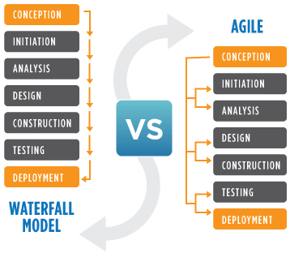
Software Development Life Cycle

Slide 4
Software Prototyping
A Software prototype is a draft version of software program that allows you to explore your ideas and show the intention behind a feature or the overall design concept to users before investing time and money into development.
A prototype typically simulates only a few aspects of, and may be completely different from, the final product.
Prototyping can be considered as a risk reduction activity

Slide 5
Prototyping Benefits
Misunderstandings between software users and developers are exposed
Missing services may be detected and confusing services may be identified
A working system is available early in the process
The prototype may serve as a basis for deriving a system specification
The system can support user training and system testing

Slide 6
Continue...
Sometimes it helps to demonstrate the concept to prospective investors to get funding for project.
It reduces risk of failure, as potential risks can be identified early.
Iteration between development team and client provides a very good and conductive environment during project.
This type of approach of developing the software is used for non-IT-literate person.

Slide 7
Prototyping Process
Identify basic requirements
Determine basic requirements including the input and output
information desired. Details, such as security, can typically be ignored.
Develop initial prototype
The initial prototype is developed that includes only user interfaces.
Review
The customers, including end-users, examine the prototype and provide feedback on potential additions or changes.
Revise and enhance the prototype
Using the feedback both the specifications and the prototype can be improved. Negotiation about what is within the scope of the contract/product may be necessary. If changes are introduced then a repeat of steps #3 and #4 may be needed.

Slide 8
Software Process
Evolutionary prototyping
An initial prototype is produced and refined through a number of stages to the final system
Throw-away prototyping
A prototype is produced to help discover requirements problems and then discarded
The system is then developed using some other development process

Slide 9
Types of Prototyping
Low-Fidelity Prototyping
▫ Paper prototyping
▫ Mockups
High-Fidelity Prototyping
▫ Macromedia Director or Flash, Smalltalk , Java Script, Microsoft Tools, HTML

Slide 10
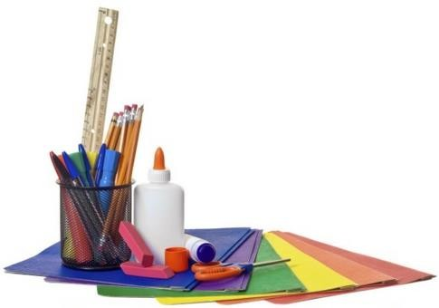
Low-Fidelity Prototyping
Tools for Paper Protyping
Pen
Pencil
Color Pencil
Rubber
Paper
Eraser
Scale
Scissor

Slide 11
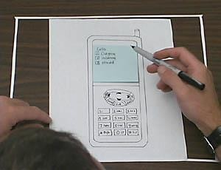
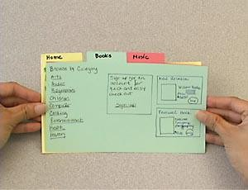
Low-Fidelity Prototyping
Does not look very much like the final product. Material, behavior
etc.
Material such as paper & cardboard rather than electronic screens, metal and detailed code.
Simple, cheap & quick to produce and redesign.
Early stage of development –prototyping for the conceptual design.

Slide 12
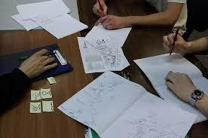
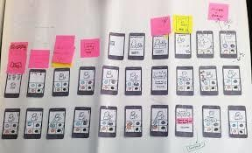
Creating Low-Fidelity Prototyping

Slide 13
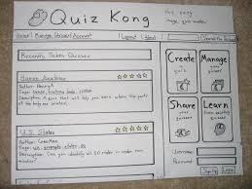
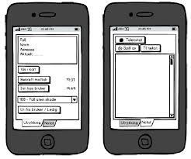
Creating Low-Fidelity Prototyping

Slide 14
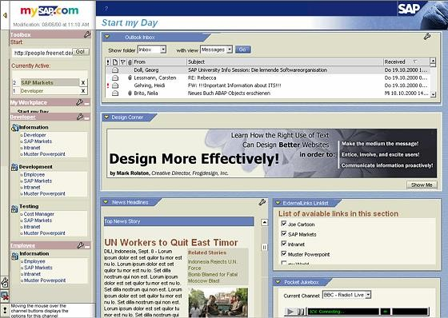
High-Fidelity Prototyping
Looks very much like the final
product.
If the prototype is for software system, a software tool, such
as Macromedia
Director or Basic or
Flash, Visual
Smalltalk, might be needed.
Software prototype tools are also often qualified development environments.
More time-consuming to produce than
low-fidelity
prototyping.

Slide 15
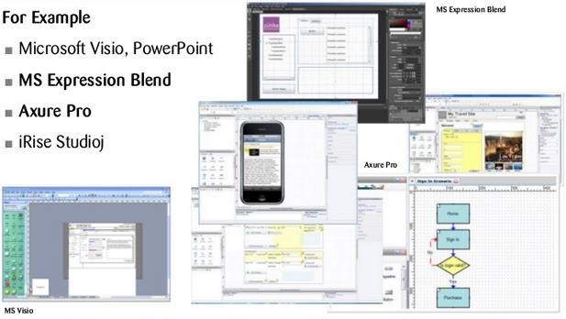
High-Fidelity Prototyping
Overview on Tools

Slide 16
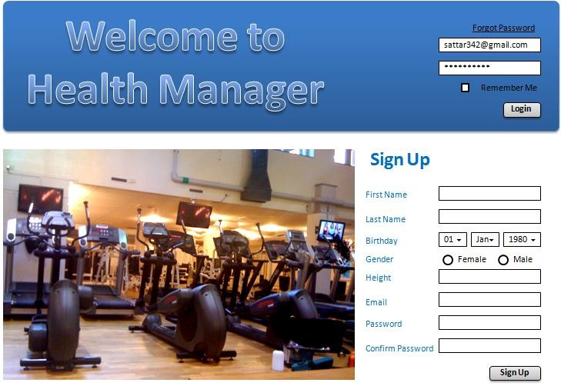
Creating High-Fidelity Prototyping(using Powerpoint)

Slide 17
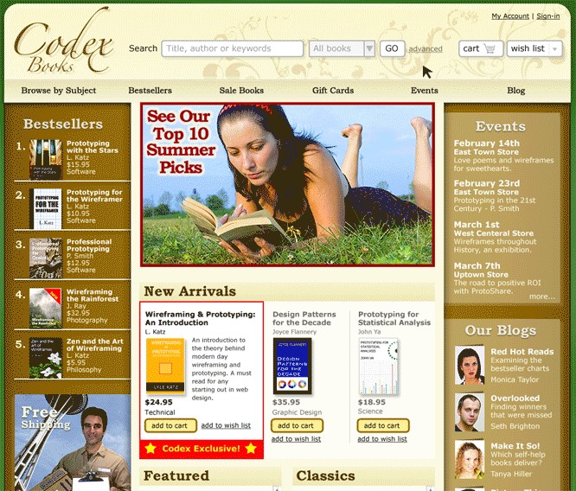
Creating High-Fidelity Prototyping(Using HTML, Java Script,css)

Slide 18
Advantages of Low-Fidelity Prototyping
Low-fidelity representations, such as sketches, differ from the final product in interaction design, visual appearance, and/or level of details. The method is quick & cheap which encourage iterative design idea tryouts between/during usability tests.
Quick Low-fidelity tests allows designers and users to focus on high-level interaction design and information architecture, rather than on details or visual style.

Slide 19
Advantages of High-Fidelity Prototyping
High-fidelity prototypes offer more realistic interactions than low-fidelity.
Better at conveying the range of design possibilities.
User-driven.

Slide 20
Design and PrototypingTopics
University Management System
Hospital Management System
Electronic Patient Record System
Online Shoping System
Smart Phone Design
Product Design (Business Idea)
Games Design
Website Developent
Recruite Management System
Tourism Software

Slide 21
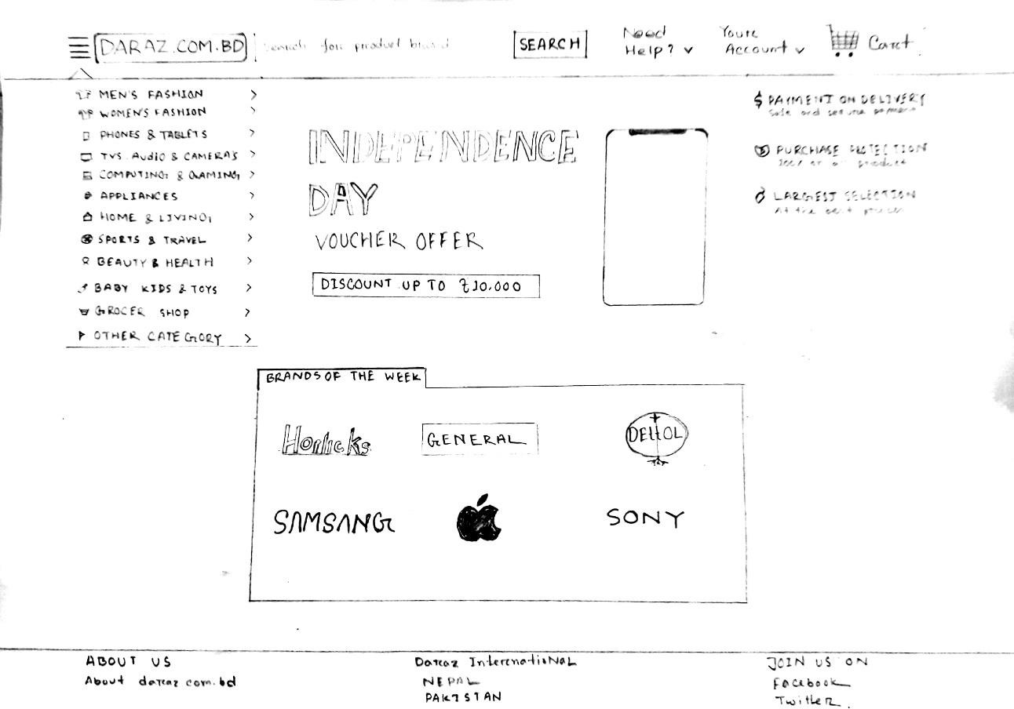
Home Page..

Slide 22
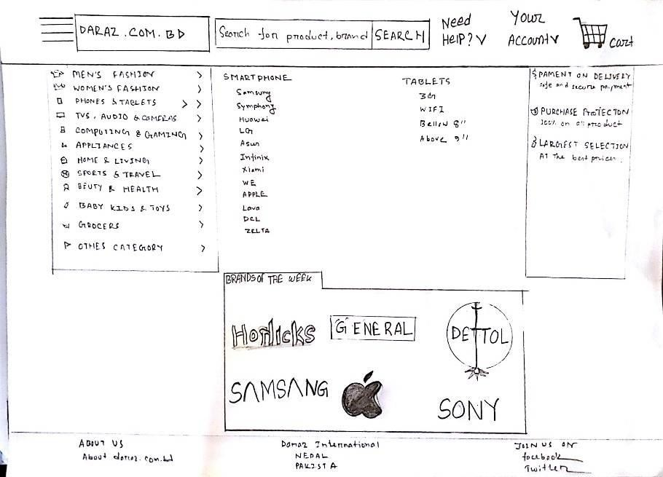
Categories…

Slide 23
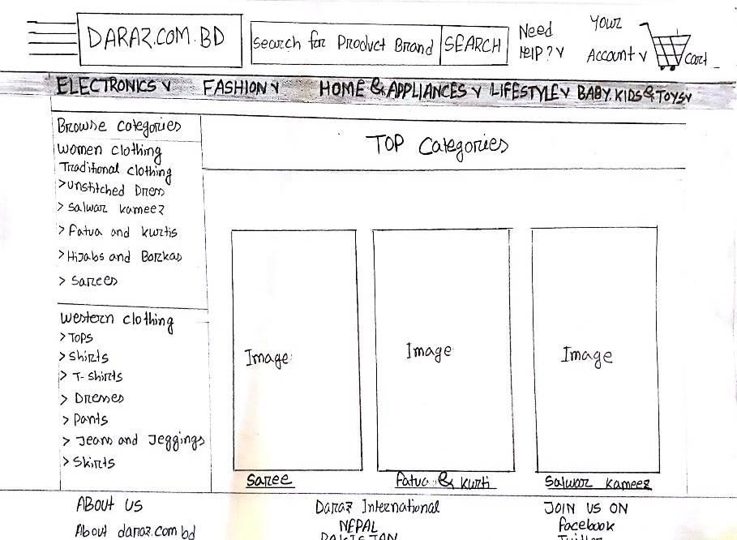
Sample..

Slide 24
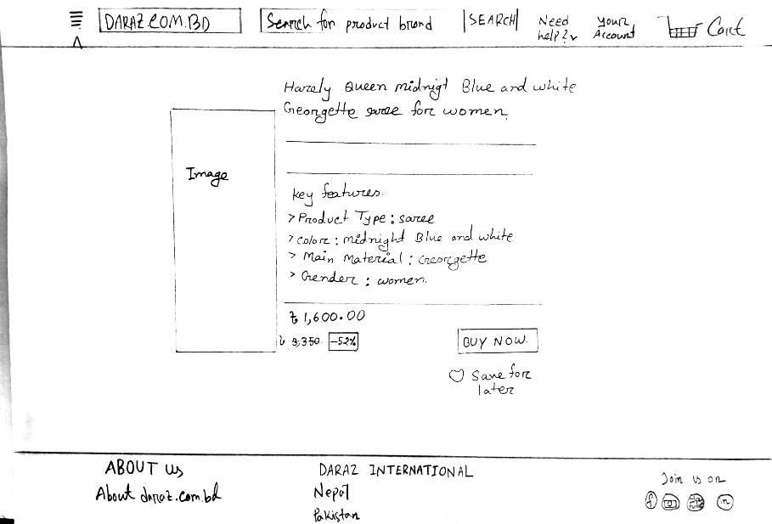
Selective product

Slide 25
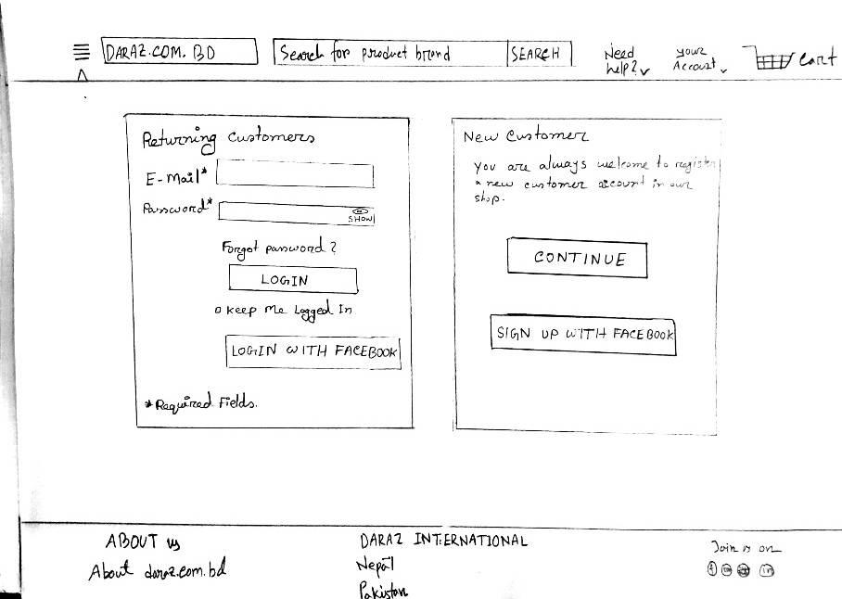
Login..

Slide 26
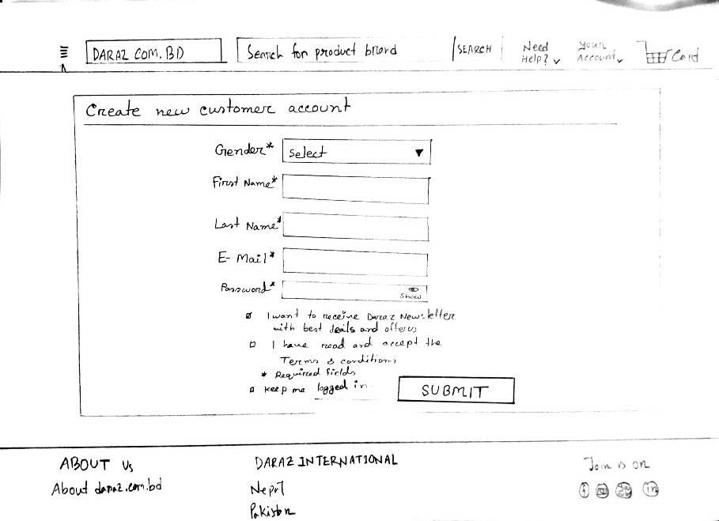
Create New Account

Slide 27
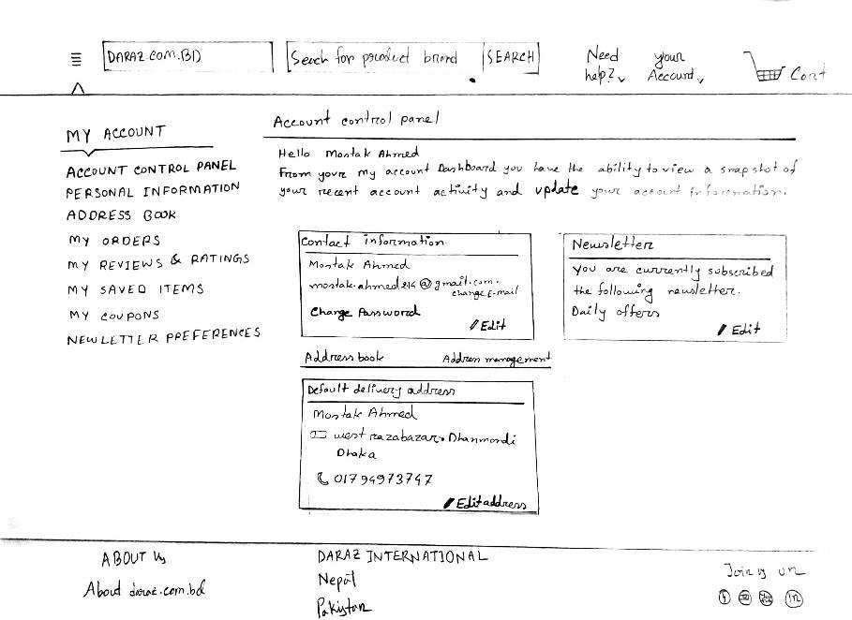
Control panel

Slide 28
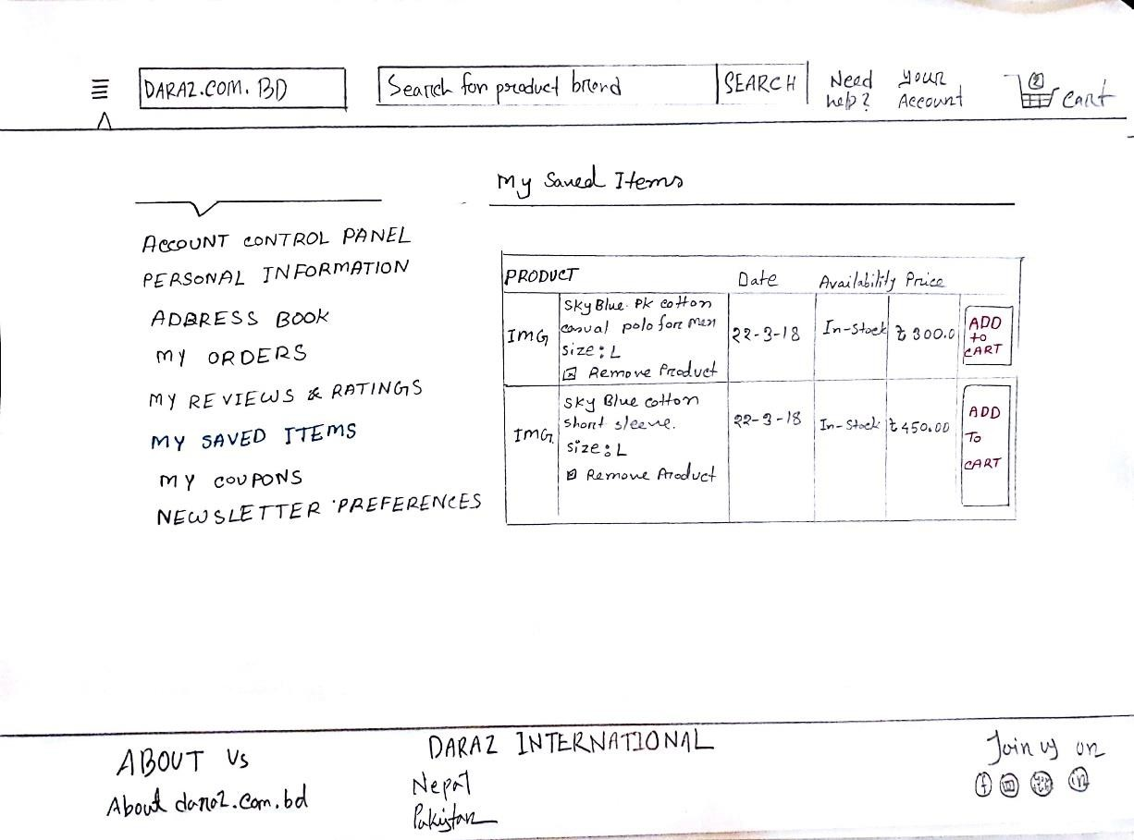
Saved Items

Slide 29
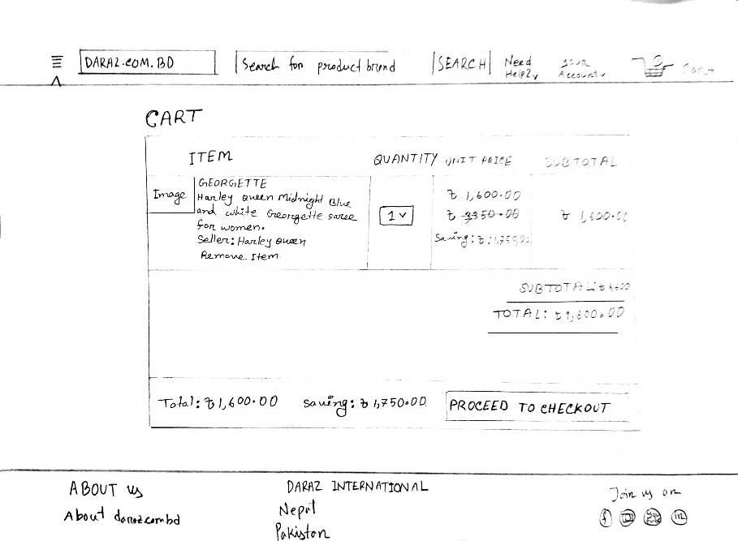
Cart

Slide 30
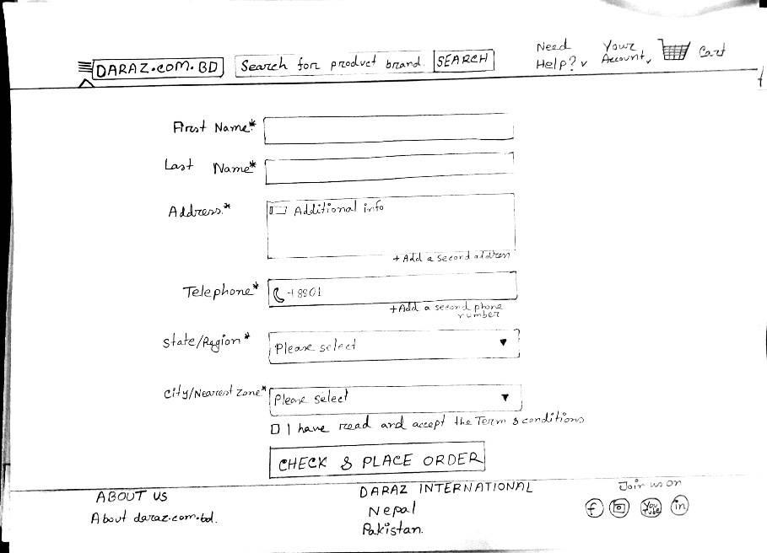
Order

Slide 31
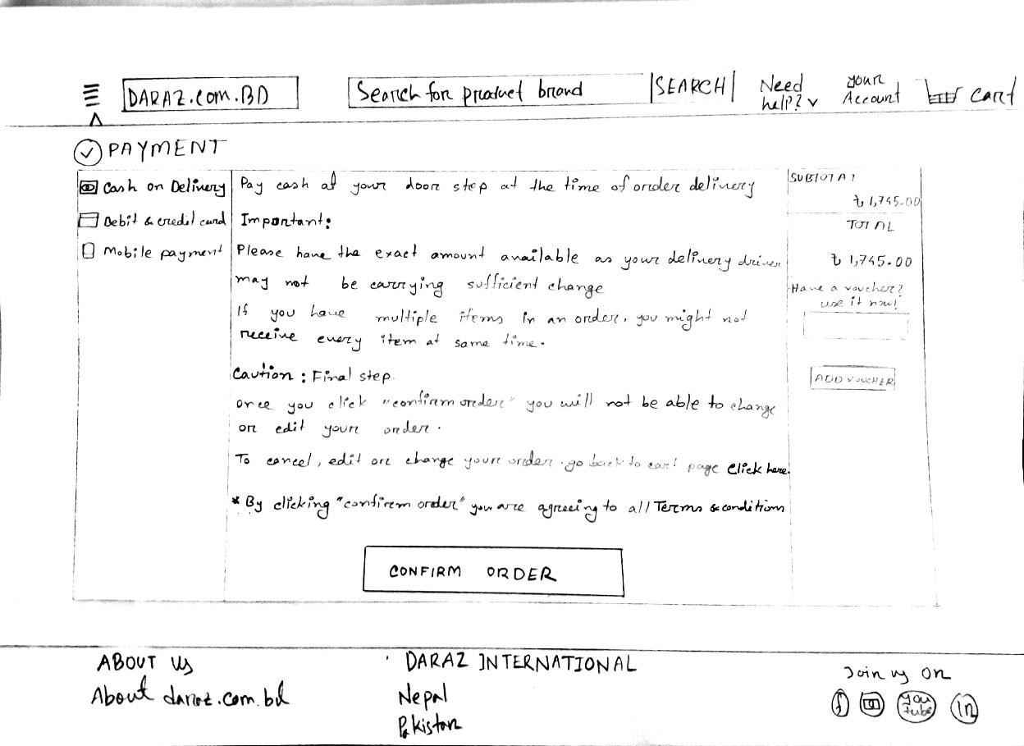
Cash on Delivery

Slide 32
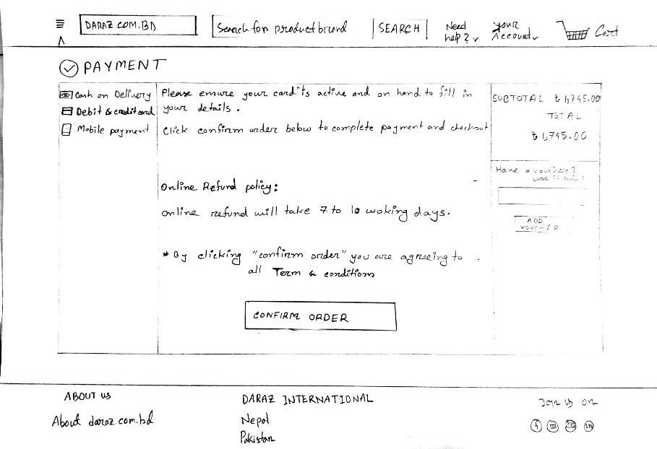
Debit & Credit card

Slide 33
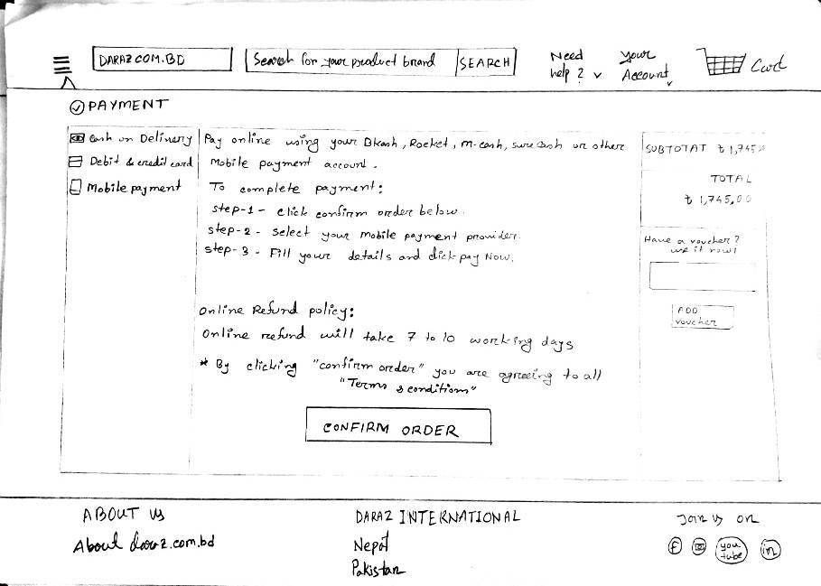
Mobile Payment

Slide 34
References:
Software Engineering by Ian Sommerville, 9th edition, Addison-Wesley, 2011
Software Engineering A practitioner’s Approach by Roger S. Pressman, 7th edition, McGraw Hill, 2010
Norman, D.A. 1988. The Psychology of everyday
things. Basic Books.
Snyder C. 2003. Paper prototyping. Morgan Kaufmann.
Preece, Rogers, Sharp. 2002. Interaction Design beyond human-computer interaction.
.

